Slide 1

Introduction to Probabilistic Machine Learning
Ralf Herbrich
Bayesian Classification

Slide 2
Overview
Bayesian Classification Learning
Bayesian Classification Learning via Approximate Message Passing

Slide 3
Overview
Bayesian Classification Learning
Bayesian Classification Learning via Approximate Message Passing

Slide 4




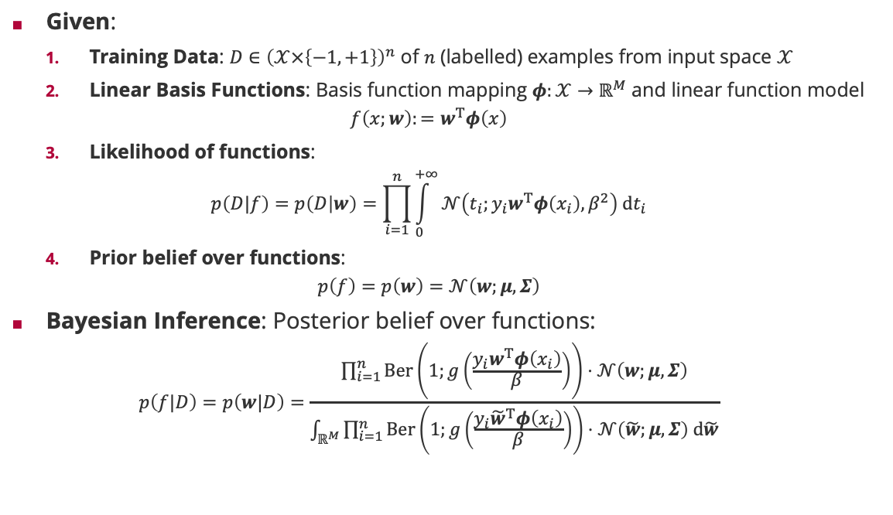


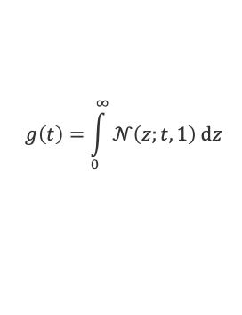


Bayesian Classification Learning Setting
Given:
Training Data: $D∈{\left(𝒳×\left\{−1,+1\right\}\right)}^{n}$ of $n$ (labelled) examples from input space $𝒳$
Linear Basis Functions: Basis function mapping $φ:𝒳→ℝ^{M}$ and linear function model
$$f\left(x;w\right):=w^{T}φ\left(x\right)$$
Likelihood of functions:
$$p\left(D|f\right)=p\left(D | w\right)=\prod_{i=1}^{n}{\int_{0}^{+∞}{𝒩\left(t_{i};y_{i}w^{T}φ\left(x_{i}\right),β^{2}\right) dt_{i}}}$$
Prior belief over functions:
$$p\left(f\right)=p\left(w\right)=𝒩\left(w;μ,Σ\right)$$
Bayesian Inference: Posterior belief over functions:
$$p\left(f|D\right)=p\left(w|D\right)=\frac{\prod_{i=1}^{n}{Ber\left(1;g\left(\frac{y_{i}w^{T}φ\left(x_{i}\right)}{β}\right)\right)}⋅𝒩\left(w;μ,Σ\right)}{\int_{ℝ^{M}}{\prod_{i=1}^{n}{Ber\left(1;g\left(\frac{y_{i}{\tilde{w}}^{T}φ\left(x_{i}\right)}{β}\right)\right)}⋅𝒩\left(\tilde{w};μ,Σ\right) d\tilde{w}}}$$
$$g\left(t\right)=\int_{0}^{∞}{𝒩\left(z;t,1\right) dz}$$
weight vector
feature vector
$$Ber\left(1;g\left(\frac{y_{i}w^{T}φ\left(x_{i}\right)}{β}\right)\right)$$
$$𝒩\left(W;μ,Σ\right)$$
$$\lim_{s→∞}{g\left(s⋅t\right)}=𝕀\left(t>0\right)$$
$$W$$
$$i=1,…,n$$
$$𝒩\left(T_{i};{y_{i}W}^{T}φ\left(x_{i}\right),β^{2}\right)$$
$$T_{i}$$
$$𝕀\left(T_{i}>0 \right)$$

Slide 5
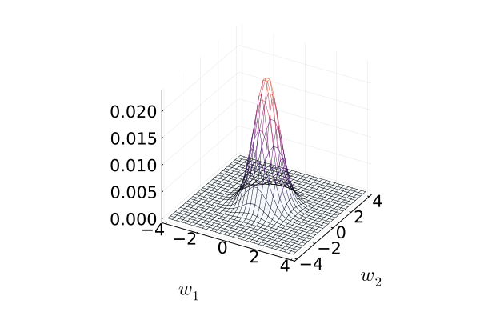
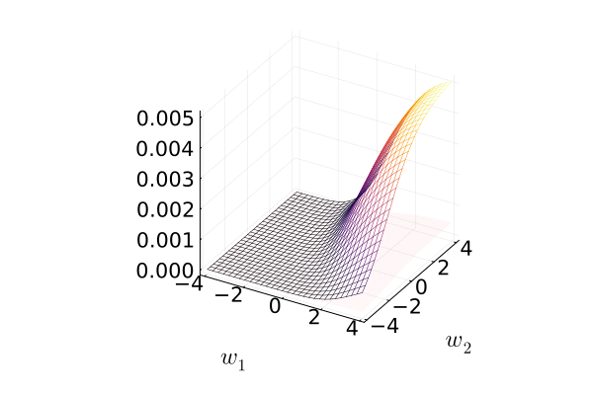
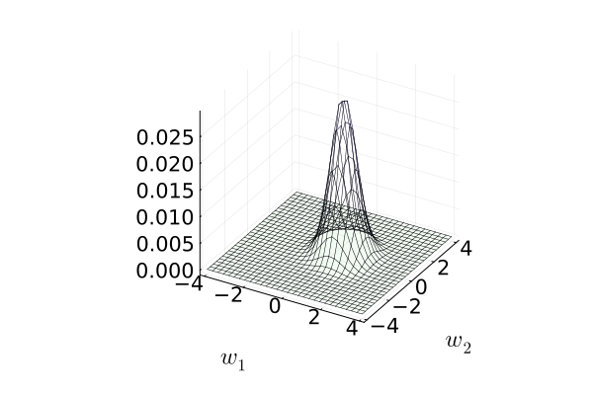
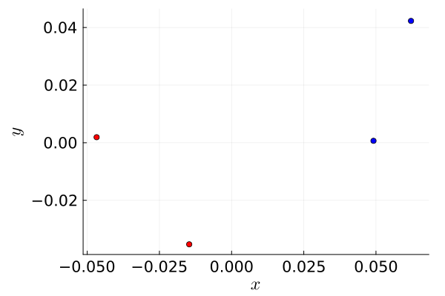
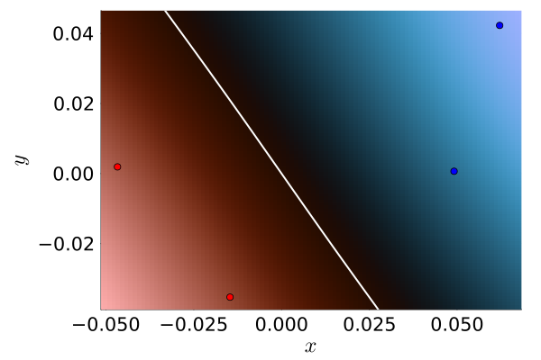
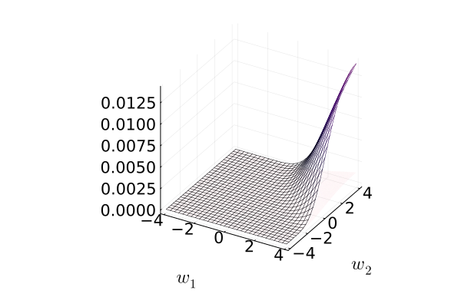
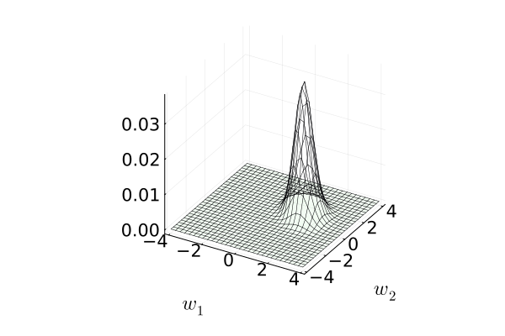
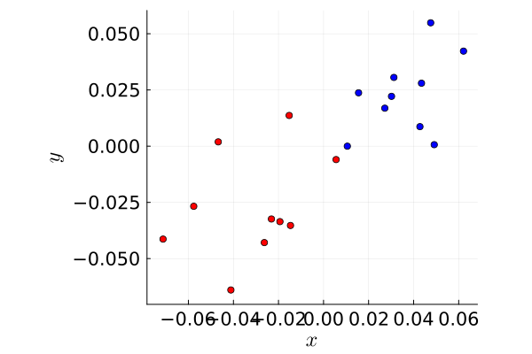
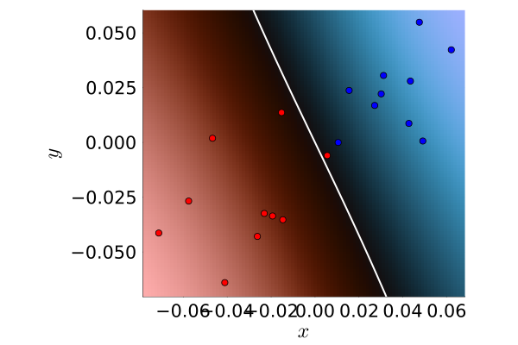
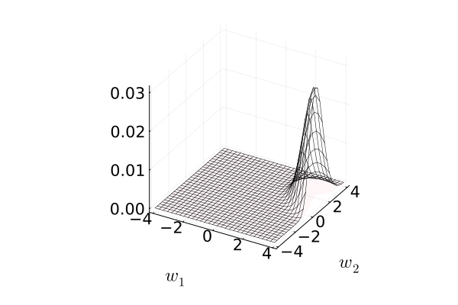
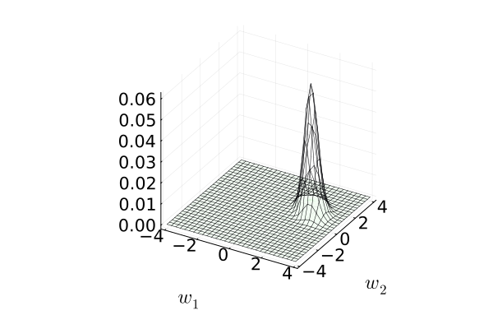
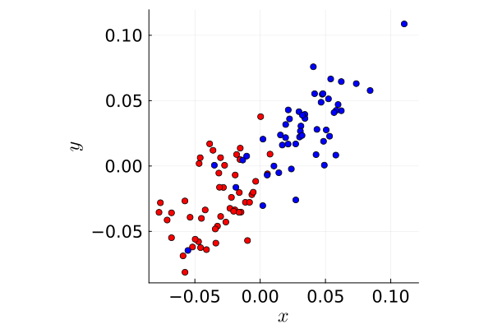
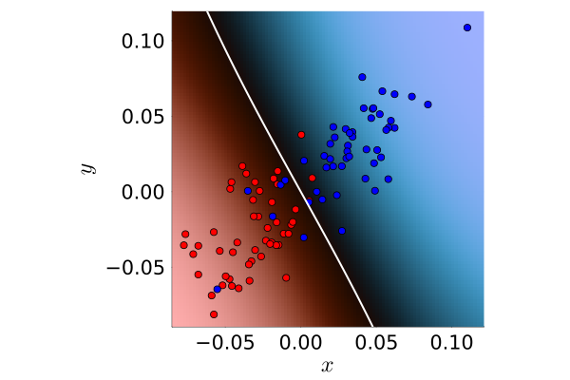



Bayesian Classification Learning in Pictures
Prior
Input Data
Likelihood
Posterior
Predictive Distribution
$$n=4$$
$$n=20$$
$$n=100$$

Slide 6
Overview
Bayesian Classification Learning
Bayesian Classification Learning via Approximate Message Passing

Slide 7
































Update Equations for Combined Factors
Gaussian Projection-Noise Factor $𝒩\left({T;W}^{T}x,β^{2}\right)$
$$𝒩\left(W;μ,Σ\right)$$
$$m_{f→T}\left(t\right)=𝒩\left(t;μ^{T}x,x^{T}Σx+β^{2}\right)$$
$$𝒩\left(⋅;μ,Σ \right)$$
$$m_{f→T}\left(⋅\right)$$
$$W$$
$$W$$
$$T$$
$$m_{f→W}\left(w\right)=𝒢\left(w;\frac{m}{s^{2}+β^{2}}x,\frac{1}{s^{2}+β^{2}}xx^{T}\right)$$
$$i=1,…,n$$
$$m_{f→W}\left(⋅\right)$$
$$𝒩\left(⋅;m,s^{2} \right)$$
$$𝒩\left(T_{i};y_{i}W^{T}φ\left(x_{i}\right),β^{2}\right)$$
$$T_{i}$$
$$m_{f→T}\left(t\right)=\int{𝒩\left(t;w^{T}x,β^{2}\right)⋅}𝒩\left(w;μ,Σ\right) dw=\int{\left[\int{δ\left(z−w^{T}x\right)⋅}𝒩\left(w;μ,Σ\right) dw\right]⋅}𝒩\left(t;z,β^{2}\right) dz$$
$$𝕀\left(T_{i}>0 \right)$$
$$m_{f→w}\left(w\right)=\int{𝒩\left(t;w^{T}x,β^{2}\right)⋅}𝒩\left(t;m,s^{2}\right) dt=\int{\left[\int{𝒩\left(t;z,β^{2}\right)⋅}𝒩\left(t;m,s^{2}\right) dt\right]⋅δ\left(z−w^{T}x\right)} dz$$
$$𝒩\left(⋅;μ,Σ \right)$$
$$m_{f→T}\left(⋅\right)$$
$$m_{1}\left(z\right)=𝒩\left(z;μ^{T}x,x^{T}Σx\right)$$
$$m_{1}\left(⋅\right)$$
$$m_{1}\left(⋅\right)$$
$$W$$
$$Z$$
$$T$$
$$m_{2}\left(z\right)=𝒩\left(z;m,s^{2}+β^{2}\right)$$
$$m_{f→W}\left(⋅\right)$$
$$m_{2}\left(⋅\right)$$
$$m_{2}\left(⋅\right)$$
$$𝒩\left(⋅;m,s^{2} \right)$$
$$δ\left({Z−W}^{T}x\right)$$
$$𝒩\left(Z;T,β^{2}\right)$$
Helper factor tree to derive closed form message equations

Slide 8








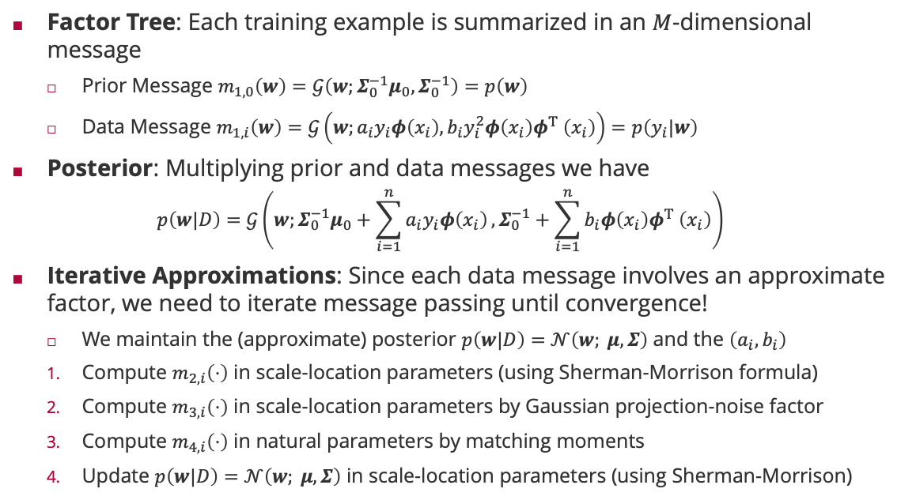














Bayesian Linear Classification by Message Passing
$$𝒩\left(W;μ_{0},Σ_{0}\right)$$
Factor Tree: Each training example is summarized in an $M$-dimensional message
Prior Message $m_{1,0}\left(w\right)=𝒢\left(w;Σ_{0}^{−1}μ_{0},Σ_{0}^{−1}\right)=p\left(w\right)$
Data Message $m_{1,i}\left(w\right)=𝒢\left(w;a_{i}y_{i}φ\left(x_{i}\right),b_{i}y_{i}^{2}φ\left(x_{i}\right)φ^{T} \left(x_{i}\right)\right)=p\left(y_{i}|w\right)$
Posterior: Multiplying prior and data messages we have
$$p\left(w|D\right)=𝒢\left(w;Σ_{0}^{−1}μ_{0}+\sum_{i=1}^{n}{a_{i}y_{i}φ\left(x_{i}\right)},Σ_{0}^{−1}+\sum_{i=1}^{n}{b_{i}φ\left(x_{i}\right)φ^{T} \left(x_{i}\right)}\right)$$
Iterative Approximations: Since each data message involves an approximate factor, we need to iterate message passing until convergence!
We maintain the (approximate) posterior $p\left(w|D\right)=$ $𝒩\left(w; μ,Σ\right)$ and the $\left(a_{i},b_{i}\right)$
Compute $m_{2,i}\left(⋅\right)$ in scale-location parameters (using Sherman-Morrison formula)
Compute $m_{3,i}\left(⋅\right)$ in scale-location parameters by Gaussian projection-noise factor
Compute $m_{4,i}\left(⋅\right)$ in natural parameters by matching moments
Update $p\left(w|D\right)=$ $𝒩\left(w; μ,Σ\right)$ in scale-location parameters (using Sherman-Morrison)
$$y_{i}^{2}=1$$
$$m_{1,0}\left(⋅\right)$$
$$m_{1,1}\left(⋅\right)$$
$$W$$
$$m_{1,n}\left(⋅\right)$$
$$𝒩\left(T_{1};y_{1}W^{T}φ\left(x_{1}\right),β^{2}\right)$$
$$m_{2,1}\left(⋅\right)$$
$$m_{2,n}\left(⋅\right)$$
$$𝒩\left(T_{n};{y_{n}W}^{T}φ\left(x_{n}\right),β^{2}\right)$$
$$m_{4,1}\left(⋅\right)$$
$$m_{3,1}\left(⋅\right)$$
$$m_{4,n}\left(⋅\right)$$
$$m_{3,n}\left(⋅\right)$$
$$T_{1}$$
$$T_{n}$$
$$m_{4,1}\left(⋅\right)$$
$$m_{3,1}\left(⋅\right)$$
$$m_{4,n}\left(⋅\right)$$
$$m_{3,n}\left(⋅\right)$$
$$𝕀\left(T_{1}>0\right)$$
$$𝕀\left(T_{n}>0\right)$$

Slide 9


































Relation of Bayesian Linear Classification to Regression
Linear Regression
Linear Classification
$$𝒩\left(W;μ_{0},Σ_{0}\right)$$
$$𝒩\left(W;μ_{0},Σ_{0}\right)$$
$$m_{1,0}\left(w\right)=𝒩\left(w;μ_{0},Σ_{0}\right)$$
$$m_{1,0}\left(⋅\right)$$
$$m_{1,0}\left(⋅\right)$$
$$m_{1,1}\left(⋅\right)$$
$$W$$
$$m_{1,n}\left(⋅\right)$$
$$m_{1,1}\left(⋅\right)$$
$$W$$
$$m_{1,n}\left(⋅\right)$$
$$δ\left(T_{1}−W^{T}φ\left(x_{1}\right)\right)$$
$$δ\left(T_{n}−W^{T}φ\left(x_{n}\right)\right)$$
$$𝒩\left(T_{1};y_{1}W^{T}φ\left(x_{1}\right),β^{2}\right)$$
$$𝒩\left(T_{n};{y_{n}W}^{T}φ\left(x_{n}\right),β^{2}\right)$$
$$m_{4,1}\left(⋅\right)$$
$$m_{4,n}\left(⋅\right)$$
$$m_{4,1}\left(⋅\right)$$
$$m_{4,n}\left(⋅\right)$$
$$T_{1}$$
$$T_{n}$$
$$T_{1}$$
$$T_{n}$$
$$m_{4,1}\left(⋅\right)$$
$$m_{4,n}\left(⋅\right)$$
$$m_{4,1}\left(⋅\right)$$
$$m_{4,n}\left(⋅\right)$$
$$𝒩\left(y_{1};T_{1},β^{2}\right)$$
$$𝒩\left(y_{n};T_{n},β^{2}\right)$$
$$𝕀\left(T_{1}>0\right)$$
$$𝕀\left(T_{n}>0\right)$$
$$m_{1,i}\left(w\right)=𝒢\left(w;β^{−2}y_{i}φ\left(x_{i}\right),β^{−2}φ\left(x_{i}\right)φ^{T} \left(x_{i}\right)\right)$$
$$m_{1,i}\left(w\right)=𝒢\left(w;a_{i}y_{i}φ\left(x_{i}\right),b_{i}φ\left(x_{i}\right)φ^{T} \left(x_{i}\right)\right)$$
The $a_{i}$ and $b_{i}$ are effectively
precision-mean and precision of the message $m_{4,i}\left(⋅\right)$!

Slide 10

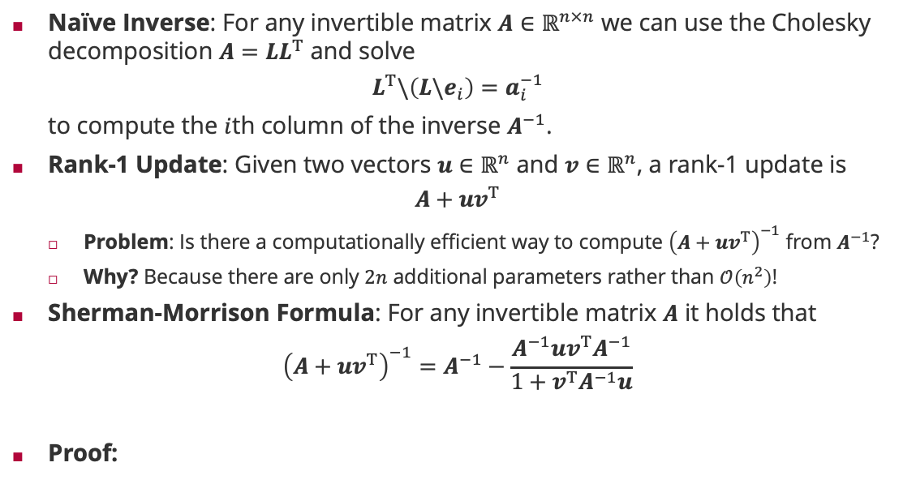



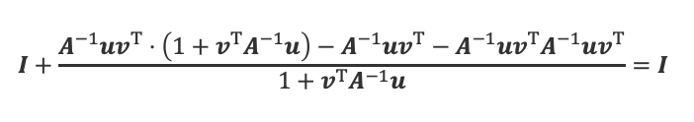

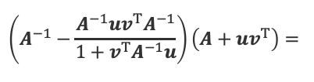
Matrix Inverse of a Rank-1 Update
Naïve Inverse: For any invertible matrix $A∈ℝ^{n×n}$ we can use the Cholesky decomposition $A=LL^{T}$ and solve
$$L^{T}\backslash \left(L\backslash e_{i}\right)=a_{i}^{−1}$$
to compute the $i$th column of the inverse $A^{−1}$.
Rank-1 Update: Given two vectors $u∈ℝ^{n}$ and $v∈ℝ^{n}$, a rank-1 update is
$$A+uv^{T}$$
Problem: Is there a computationally efficient way to compute ${\left(A+uv^{T}\right)}^{−1}$ from $A^{−1}$?
Why? Because there are only $2n$ additional parameters rather than $𝒪\left(n^{2}\right)$!
Sherman-Morrison Formula: For any invertible matrix $A$ it holds that
$${\left(A+uv^{T}\right)}^{−1}=A^{−1}−\frac{A^{−1}uv^{T}A^{−1}}{1+v^{T}A^{−1}u}$$
Proof:
$𝒪\left(n^{3}\right)$ over $i=1,…,n$
$$𝒪\left(n^{2}\right)$$
$$𝒪\left(n^{2}\right)$$
$$𝒪\left(n^{2}\right)$$
$$\left(A^{−1}−\frac{A^{−1}uv^{T}A^{−1}}{1+v^{T}A^{−1}u}\right)\left(A+uv^{T}\right)=$$
$$I+\frac{A^{−1}uv^{T}⋅\left(1+v^{T}A^{−1}u\right)−A^{−1}uv^{T}−A^{−1}uv^{T}A^{−1}uv^{T}}{1+v^{T}A^{−1}u}=I$$
$${\left(A+uv^{T}\right)}^{−1}\left(A+uv^{T}\right)=$$

Slide 11













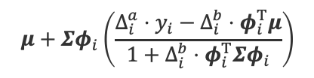


Steps 1 & 4: Update Data Message and Marginal
$$𝒩\left(W;μ,Σ\right)$$
Rank-1 Updates of $Σ$ and $μ$ with addition of $Δ_{i}^{a}⋅y_{i}φ_{i}$ and $Δ_{i}^{b}⋅φ_{i}φ_{i}^{T}$
$$Σ_{new }={\left(Σ^{−1}+Δ_{i}^{b}φ_{i}φ_{i}^{T}\right)}^{−1}=Σ−\frac{Δ_{i}^{b}}{1+Δ_{i}^{b}⋅φ_{i}^{T}Σφ_{i}}⋅\left(Σφ_{i}\right){\left(Σφ_{i}\right)}^{T}$$
Step 1: Compute $m_{2,i}\left(w\right)$ by removing $i$th data factor using $Δ_{i}^{a}=−a_{i}$ and $Δ_{i}^{b}=−b_{i}$
Step 4: Update $μ$ and $Σ$ of $p\left(w|D\right)$ using $Δ_{i}^{a}=a_{i}^{new}−a_{i}$ and $Δ_{i}^{b}=b_{i}^{new}−b_{i}$
Precision matrix
$$m_{1,1}\left(⋅\right)$$
$$W$$
$$m_{1,n}\left(⋅\right)$$
$$m_{2,1}\left(⋅\right)$$
$$m_{2,n}\left(⋅\right)$$
No inverse needed but just matrix multiplications!
$$T_{1}$$
$$T_{n}$$
$$μ_{new }={\left(Σ^{−1}+Δ_{i}^{b}φ_{i}φ_{i}^{T}\right)}^{−1}\left(Σ^{−1}μ+Δ_{i}^{a}y_{i}φ_{i}\right)=$$
$$μ+Σφ_{i}\left(\frac{Δ_{i}^{a}⋅y_{i}−Δ_{i}^{b}⋅φ_{i}^{T}μ}{1+Δ_{i}^{b}⋅φ_{i}^{T}Σφ_{i}}\right)$$
$$𝕀\left(T_{1}>0\right)$$
$$𝕀\left(T_{n}>0\right)$$
$$μ$$
$$+Δ_{i}^{a}y_{i}Σφ_{i}$$
$$−\frac{Δ_{i}^{b}}{1+Δ_{i}^{b}⋅φ_{i}^{T}Σφ_{i}}⋅\left(Σφ_{i}\right){φ_{i}}^{T}μ$$
$$−\frac{Δ_{i}^{b}Δ_{i}^{a}y_{i}}{1+Δ_{i}^{b}⋅φ_{i}^{T}Σφ_{i}}⋅\left(Σφ_{i}\right){φ_{i}}^{T}Σφ_{i}$$

Slide 12

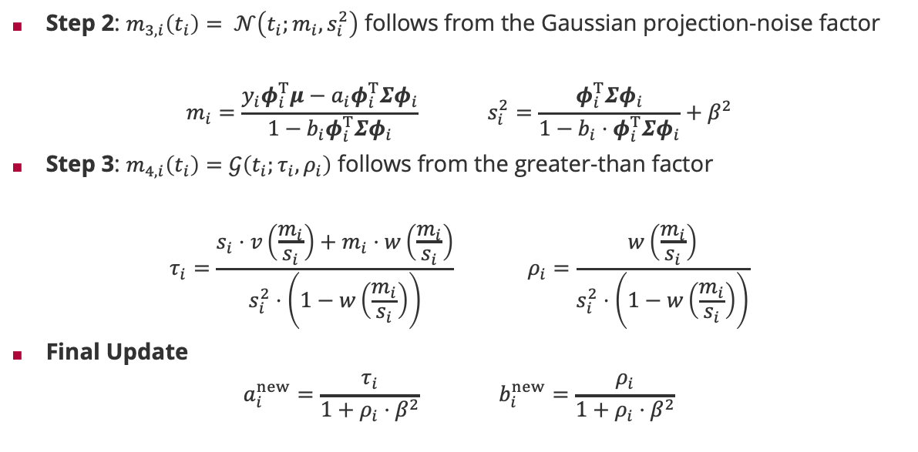
Bayesian Linear Classification: Update of $i$^{th} Data Message
$$𝒩\left(W;μ_{0},Σ_{0}\right)$$
Step 2: $m_{3,i}\left(t_{i}\right)= 𝒩\left(t_{i};m_{i},s_{i}^{2}\right)$ follows from the Gaussian projection-noise factor
$$m_{i}=\frac{y_{i}φ_{i}^{T}μ−a_{i}φ_{i}^{T}Σφ_{i}}{1−b_{i}φ_{i}^{T}Σφ_{i}} s_{i}^{2}=\frac{φ_{i}^{T}Σφ_{i}}{1−b_{i}⋅φ_{i}^{T}Σφ_{i}}+β^{2}$$
Step 3: $m_{4,i}\left(t_{i}\right)=𝒢\left(t_{i};τ_{i},ρ_{i}\right)$ follows from the greater-than factor
$$τ_{i}=\frac{s_{i}⋅v\left(\frac{m_{i}}{s_{i}}\right)+m_{i}⋅w\left(\frac{m_{i}}{s_{i}}\right)}{s_{i}^{2}⋅\left(1−w\left(\frac{m_{i}}{s_{i}}\right)\right)} ρ_{i}=\frac{w\left(\frac{m_{i}}{s_{i}}\right)}{s_{i}^{2}⋅\left(1−w\left(\frac{m_{i}}{s_{i}}\right)\right)}$$
Final Update
$$a_{i}^{new}=\frac{τ_{i}}{1+ρ_{i}⋅β^{2}} b_{i}^{new}=\frac{ρ_{i}}{1+ρ_{i}⋅β^{2}}$$
$$W$$
$$𝒩\left(T_{1};y_{1}W^{T}φ\left(x_{1}\right),β^{2}\right)$$
$$𝒩\left(T_{n};{y_{n}W}^{T}φ\left(x_{n}\right),β^{2}\right)$$
$$m_{4,1}\left(⋅\right)$$
$$m_{3,1}\left(⋅\right)$$
$$m_{4,n}\left(⋅\right)$$
$$m_{3,n}\left(⋅\right)$$
Mean correction of truncated Gaussian
$$T_{1}$$
$$T_{n}$$
$$m_{4,1}\left(⋅\right)$$
$$m_{3,1}\left(⋅\right)$$
$$m_{4,n}\left(⋅\right)$$
$$m_{3,n}\left(⋅\right)$$
$$𝕀\left(T_{1}>0\right)$$
$$𝕀\left(T_{n}>0\right)$$
Variance correction of truncated Gaussian

Slide 13

Bayesian Linear Classification: Putting It all Together
Given: $n$ training examples $\left(x_{i},y_{i}\right)$ where $y_{i}∈\left\{−1,+1\right\}$ and feature map $φ:𝒳→ℝ^{M}$
Initialize $φ_{i}≔φ\left(x_{i}\right)$, $Σ=λ^{2}I$, $μ=0$ and $a_{i}=b_{i}=0$
Repeat until maximum change component-wise in $a$ and $b$ is small (e.g., $≤{10}^{−6}$)
For all $i=1,…,n$
Step 1: Compute $z=Σφ_{i}$, $e=φ_{i}^{T}z, f=φ_{i}^{T}μ, c=1−b_{i}⋅e$ Step 2: Compute $m=\frac{y_{i}⋅f−a_{i}⋅e}{c}$ and $s^{2}=\frac{e}{c}+β^{2}$ Step 3: Compute $τ=\frac{s⋅V+m⋅W}{s^{2}⋅\left(1−W\right)}$ and $ρ=\frac{W}{s^{2}⋅\left(1−W\right)}$ for $V=v\left(\frac{m}{s} \right)$ and $W=w\left(\frac{m}{s}\right)$
Compute $a_{i}^{new}=\frac{τ}{1+ρ⋅β^{2}}$ and $b_{i}^{new}=\frac{ρ}{1+ρ⋅β^{2}}$
Step 4: Compute $d=1+\left(b_{i}^{new}−b_{i}\right)⋅e$
Update $Σ←Σ−\frac{b_{i}^{new}−b_{i}}{d}⋅zz^{T}$ and $μ←μ+\frac{y_{i }⋅\left(a_{i}^{new}−a_{i}\right)−f⋅\left(b_{i}^{new}−b_{i}\right)}{d}⋅z$ Update $a_{i}←a_{i}^{new}$ and $b_{i}←b_{i}^{new}$
End For
Majority of algorithm is additions, multiplication, and division of scalars!
Algorithm requires no matrix inverses – just matrix products!

Slide 14


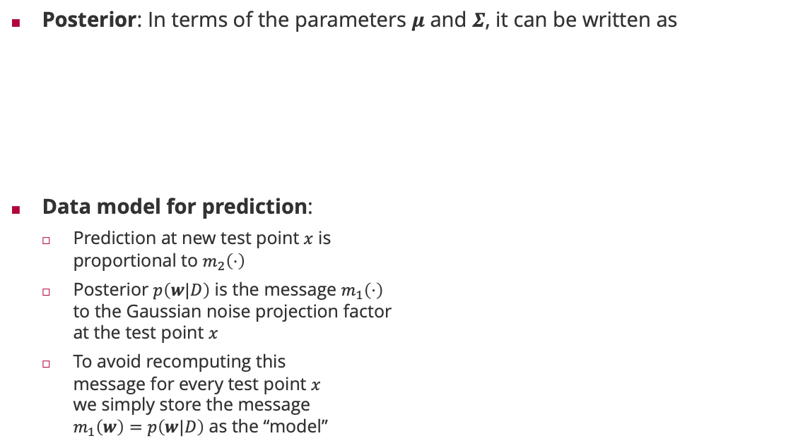


















Bayesian Classification: Training & Prediction
Posterior: In terms of the parameters $μ$ and $Σ$, it can be written as
Data model for prediction:
Prediction at new test point $x$ is proportional to $m_{2}\left(⋅\right)$
Posterior $p\left(w|D\right)$ is the message $m_{1}\left(⋅\right)$ to the Gaussian noise projection factor at the test point $x$
To avoid recomputing this message for every test point $x$ we simply store the message $m_{1}\left(w\right)=p\left(w|D\right)$ as the “model”
$$p\left(w|D\right)=𝒩\left(w;μ,Σ\right)$$
Posterior $p\left(w|D\right)$
$$𝒩\left(W;μ,Σ\right)$$
New test point
$$m_{1,0}\left(⋅\right)$$
$$m_{1}\left(⋅\right)$$
$$W$$
$$𝒩\left(T;W^{T}φ\left(x\right),β^{2}\right)$$
$$m_{1,1}\left(⋅\right)$$
$$m_{1,n}\left(⋅\right)$$
$$m_{2}\left(⋅\right)$$
$$𝒩\left(T_{1};y_{1}W^{T}φ\left(x_{1}\right),β^{2}\right)$$
$$𝒩\left(T_{n};y_{n}W^{T}φ\left(x_{n}\right),β^{2}\right)$$
$$T$$
$$m_{2,1}\left(⋅\right)$$
$$m_{2,n}\left(⋅\right)$$
$$T_{1}$$
$$T_{n}$$
$$m_{2,1}\left(⋅\right)$$
$$m_{2,n}\left(⋅\right)$$
$$𝕀\left(T_{1}>0\right)$$
$$𝕀\left(T_{n}>0\right)$$

Slide 15




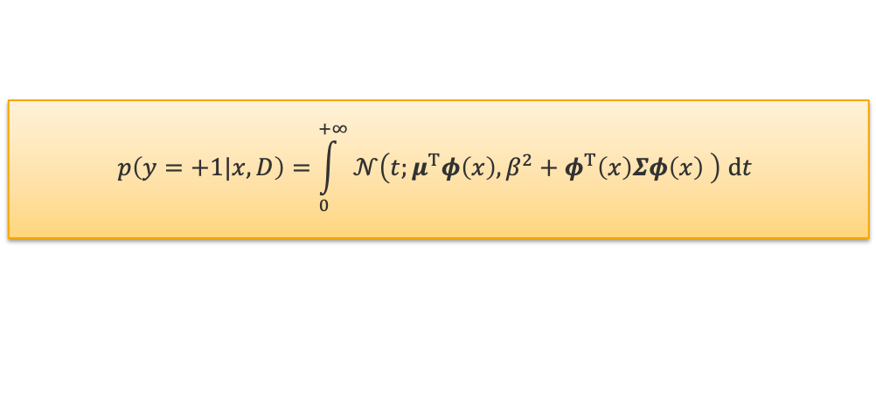




Predictions
Predicition Tree: Simple factor chain given posterior $p\left(w|x,D\right)=𝒩\left(w;μ,Σ\right)$
Posterior Message $m_{1}\left(w\right)=𝒩\left(w;μ,Σ\right)=p\left(w|x,D\right)$
Projection-Noise Message $m_{2}\left(t\right)=𝒩\left(t;μ^{T}φ\left(x\right),φ^{T}\left(x\right)Σφ\left(x\right)+β^{2}\right)=p\left(t|x,D\right)$
Outcome Probability $\int_{0}^{∞}{m_{2}\left(t\right) dt}=p\left(y=+1|x,D\right)$
Bayesian Linear Probit Regression in Matrix Notation
$$𝒩\left(W;μ,Σ\right)$$
$$m_{1}\left(⋅\right)$$
$$W$$
$$m_{1}\left(⋅\right)$$
$$𝒩\left(T;W^{T}φ\left(x\right),β^{2}\right)$$
$$m_{2}\left(⋅\right)$$
$$T$$
$$p\left(y=+1|x,D\right)=\int_{0}^{+∞}{𝒩\left(t;μ^{T}φ\left(x\right),β^{2}+φ^{T}\left(x\right)Σφ\left(x\right) \right) dt}$$
data uncertainty
model uncertainty

Slide 16
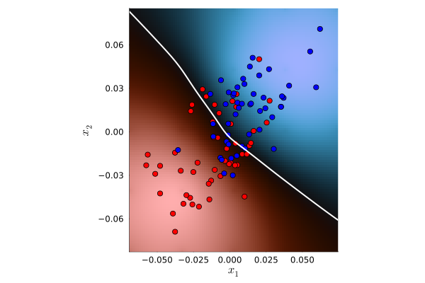
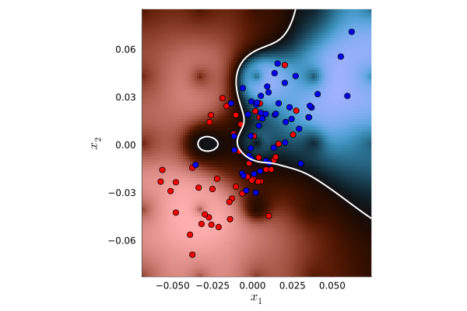
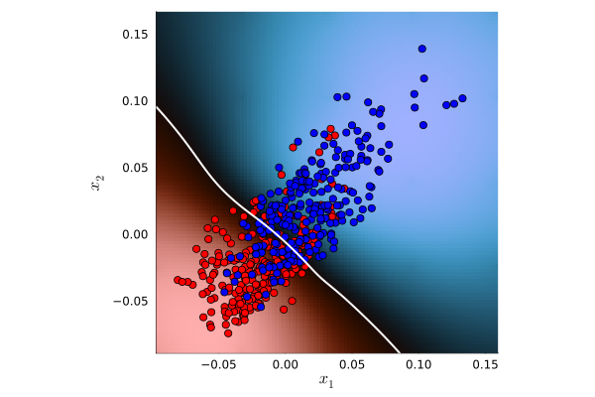
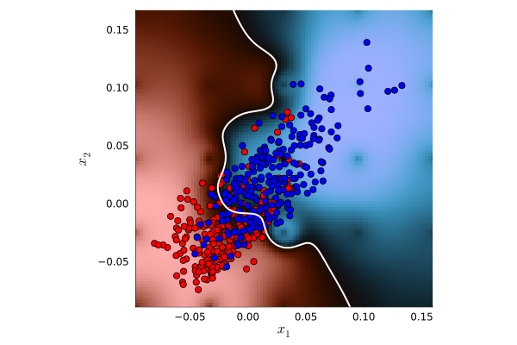


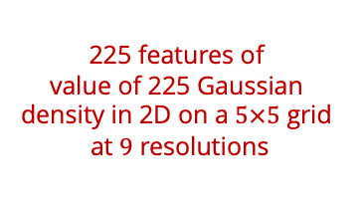


Bayesian Linear Classification in Pictures
$$λ=1$$
$$λ=10$$
225 features of value of 225 Gaussian density in 2D on a $5×5$ grid at $9$ resolutions
$$n=100$$
$$n=500$$

Slide 17
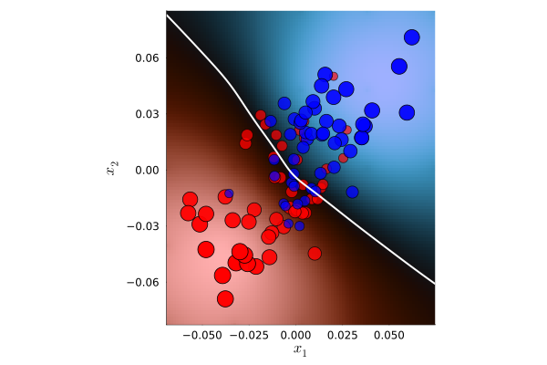
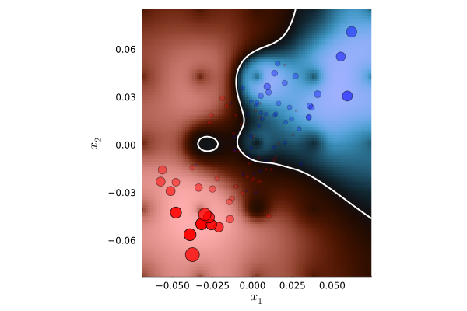
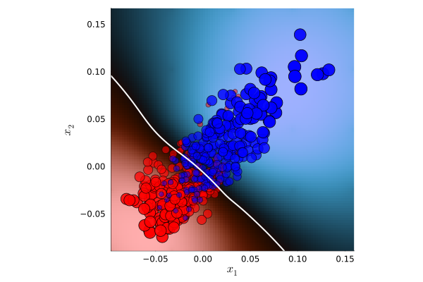
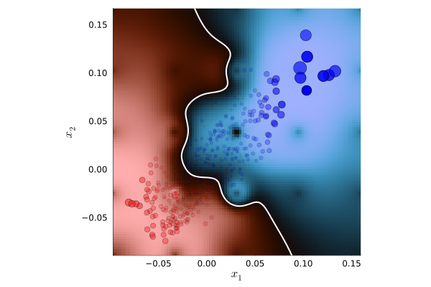
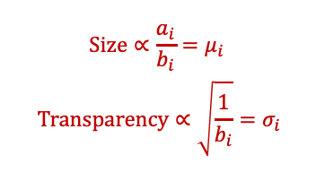


Bayesian Linear Classification in Pictures (ctd)
$$λ=1$$
$$λ=10$$
$$Size∝\frac{a_{i}}{b_{i}}=μ_{i}$$
$$Transparency∝\sqrt{\frac{1}{b_{i}}}=σ_{i}$$
$$n=100$$
$$n=500$$

Slide 18
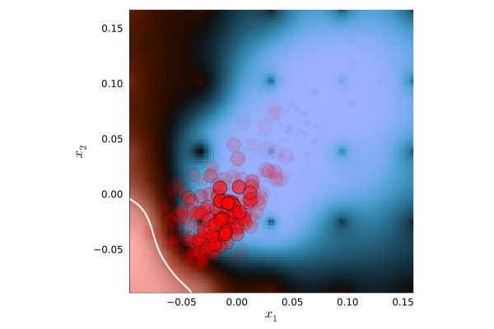


Bayesian Linear Classification Convergence Pictures
Iteration 1
Iteration 2
Iteration 3

Slide 19

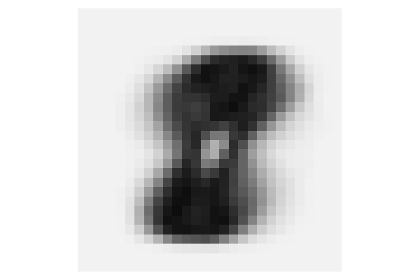

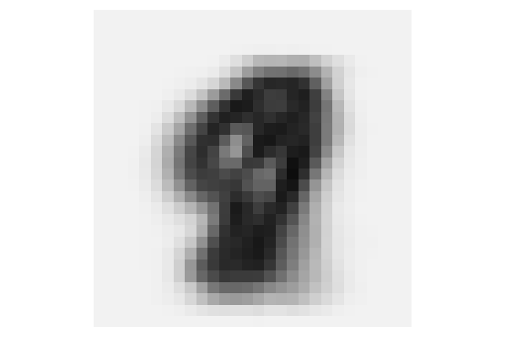




Bayesian Linear Classification for MNIST
$$μ$$
$$diag\left(Σ\right)$$
$$“1” vs. “8”$$
$$“1” vs. “9”$$

Slide 20
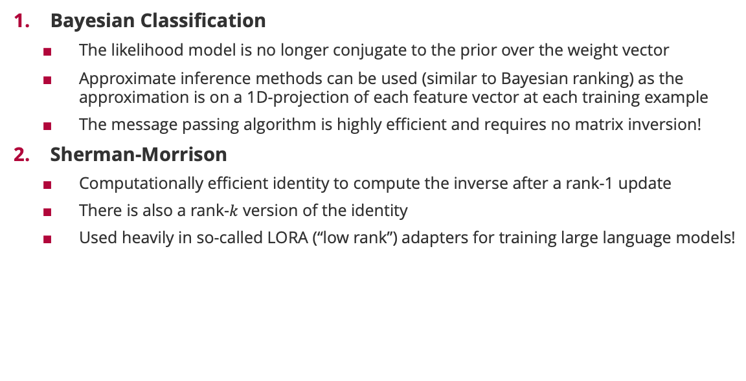
Summary
Bayesian Classification
The likelihood model is no longer conjugate to the prior over the weight vector
Approximate inference methods can be used (similar to Bayesian ranking) as the approximation is on a 1D-projection of each feature vector at each training example
The message passing algorithm is highly efficient and requires no matrix inversion!
Sherman-Morrison
Computationally efficient identity to compute the inverse after a rank-1 update
There is also a rank-$k$ version of the identity
Used heavily in so-called LORA (“low rank”) adapters for training large language models!

Slide 21
See you next week!

